Slide 1
Mechanism Design
John P Dickerson & Marina Knittel
Lecture #4 – 02/02/2022
CMSC498T
Mondays & Wednesdays
2:00pm – 3:15pm

Slide 2
What’s used in Market Design & Resource Allocation?
We want the best outcome from a set of outcomes.
Convex optimization:
Linear programming
Quadratic programming
Nonconvex optimization:
(Mixed) integer linear programming
(Mixed) integer quadratic programming
Incomplete heuristic & greedy methods
Care about maximization (social welfare, profit), minimization (regret, loss), or simple feasibility (does a stable matching with couples exist?)

Slide 3
“Programming?”
It’s just an optimization problem.
Blame this guy:
George Dantzig (Maryland alumnus!)
Focused on solving US military logistic scheduling problems aka programs
Solving (un)constrained optimization problems is much older:
Newton (e.g., Newton’s method for roots)
Gauss (e.g., Gauss-Newton’s non-linear regression)
Lagrange (e.g., Lagrange multipliers)

Slide 4
General Model
General math program:
min/max f(x)
subject to g_{i}(x) ≤ 0, i = 1, ..., m
h_{j}(x) = 0, j = 1, ..., k
x ∈ X ⊂ ℜ^{n}
f, g_{i}, h_{j} : ℜ^{n} → ℜ
Linear programming: all of f, g_{i}, h_{j} are linear (affine) functions
Nonlinear programming: at least part of f, g_{i}, h_{j} is nonlinear
Integer programming: Feasible region constrained to integers
Convex, quadratic, etc …

Slide 5
Convex Functions
“A function is convex if the line segment between any two points on its graph lies above it.”
Formally, given function f and two points x, y:
Convex or non-convex?
Notes:
Yes
e^x, e^-x both are differentiable and have second derivative strictly positive (e^x, e^-x respectively), so Yes
Positive definite: z’ Q z > 0 for all non-trivial z aka all positive eigenvalues -- Yes
No (second derivative not strict above)
Yes
Log/Sqrt – no, monotonically increasing but are concave (on their domain) not convex

Slide 6
Convex Sets
“A set is convex if, for every pair of points within the set, every point on the straight line segment that joins them is in the set.”
Formally, give a set S and two points x, y in S:
Convex or non-convex sets?
Notes:
Yes
Yes Yes (set of all positive semidefinite matrices) Yes

Slide 7
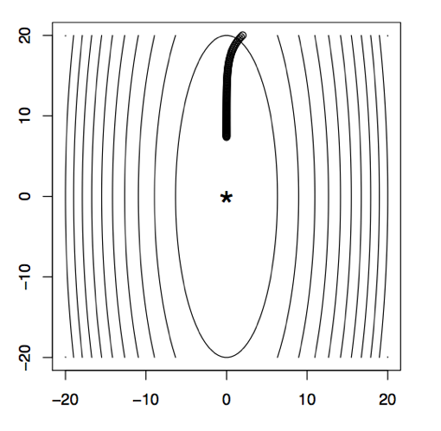
So what?
An optimization (minimization) problem with a convex objective function and a convex feasible region is solved via convex programming.
Lets us use tools from convex analysis
Local minima are global minima
The set of global mimina is convex
There is a unique global minimum if strictly convex
Lets us make statements like gradient descent converges to a global minimum (under some assumptions w.r.t local Lipschitz and step size)
But let’s start even simpler …

Slide 8
Linear Programs!
There are 3 main parts that forms an optimization problem:
Decision variables represent the decision that can be made
Objective function: Each optimization problem is trying to optimize (maximize/minimize) some goal such as costs, profits, revenue.
Constraints: Set of real restricting parameters that are imposed in real life or by the structure of the problem. Example for constraints can be:
Limited budget for a project
Limited manpower or resources
Being limited to choose only one option out of many options (Assignment)
SN

Slide 9
Linear Programs
An “LP” is an optimization problem with a linear objective function and linear constraints.
A line drawn between any two points x, y on a line is on the line → clearly convex
Feasible region aka polytope also convex
General LP:
min/max c^{T}x
subject to Ax ≤ b
x ≥ 0
Where c, A, b are known, and we are solving for x.

Slide 10
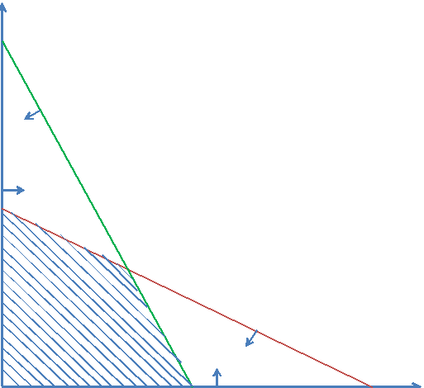
Feasible Region
The feasible region is defined by the set of constraints of the problem, which is all the possible points that satisfy the all the constraints.
Notes:
Red line is for the first constraint
And the green line is the second constraint

Slide 11
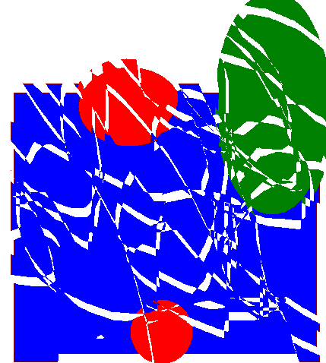

LP: Example
We make reproductions of two paintings:
Painting 1 sells for $30, painting 2 sells for $20
Painting 1 requires 4 units of blue, 1 green, 1 red
Painting 2 requires 2 blue, 2 green, 1 red
We have 16 units blue, 8 green, 5 red
maximize 30x + 20y
subject to
4x + 2y ≤ 16
x + 2y ≤ 8
x + y ≤ 5
x ≥ 0
y ≥ 0
Objective ???????
Constraints ???????
VC

Slide 12
Solving the linear program graphically
8
maximize 30x + 20y
subject to
4x + 2y ≤ 16
x + 2y ≤ 8
x + y ≤ 5
x ≥ 0
y ≥ 0
6
4
optimal solution: x=3, y=2
2
0
2
4
6
8
VC

Slide 13
LP Example: Solving for 2-P Zero-Sum Nash
Recall:
Mixed Nash Equilibrium always exists
Even if I know your strategy, in equilibrium I don’t deviate
Given a payoff matrix A:
If Row announces strategy <x₁, x₂>, then Col gets expected payoffs:
E[“Morality”] = -3x₁ + 2x₂
E[“Tax-Cuts”] = 1x₁ – 1x₂
So Col will best respond with max(-3x₁ + 2x_{2,} 1x₁ – 1x₂) …
 | Morality | Tax-Cuts
Economy | +3, -3 | -1, +1
Society | -2, +2 | +1, -1
[Example from Daskalakis]

Slide 14
LP Example: Solving for 2-P Zero-Sum Nash
But if Col gets max(-3x₁ + 2x₂, 1x₁ – 1x₂), then Row gets -max(-3x₁ + 2x₂, 1x₁ – 1x₂) = min(…)
So, if Row must announce, she will choose the strategy:
<x1, x2> = arg max min(3x₁ - 2x₂, -1x₁ + 1x₂)
This is just an LP:
maximize z
such that 3x₁ - 2x₂ > z
-1x₁ + 1x₂ > z
x₁ + x₂ = 1
x₁, x₂ > 0
So Row player is guaranteed to get at least z

Slide 15
LP Example: Solving for 2-P Zero-Sum Nash
Can set up the same LP for the Col player, to get general LPs:
max z_{R} min z_{C}
s.t. (xA)_{j} > z_{R} for all j s.t. (Ay)_{i} < z_{C} for all i
Σ_{i} x_{i} = 1 Σ_{j} y_{j} = 1
x > 0 y > 0
Know:
Row gets at least z_{R}, and exactly z_{R} if Col plays equilibrium response to announced strategy (has no incentive to deviate, loses exactly z_{R} = z*)
Col gets at most z_{C}, and exactly z_{C} if Row plays equilibrium response to announced strategy (has no incentive to deviate, gains exactly z_{C} = z*)
So these form an equilibrium: z_{R} = z* = z_{C}, since:
Row cannot increase gain due to Col being guaranteed max loss z_{C}
Col cannot decrease loss due to Row being guaranteed min gain z_{R}
Notes:
A is payoff matrix with elements that are positive for Row negative for Col

Slide 16
Example: Chicken
Dodge
Straight
S
D
D
S
D
0, 0 | -1, 1
1, -1 | -5, -5
????????
????????
S
Thankfully, (D, S) and (S, D) are Nash equilibria
They are pure-strategy Nash equilibria: nobody randomizes
They are also strict Nash equilibria: changing your strategy makes you strictly worse off
No other pure-strategy Nash equilibria
VC

Slide 17
Chicken
D
S
D
0, 0 | -1, 1
1, -1 | -5, -5
S
Is there an NE that uses mixed strategies?
Say, where player 1 uses a mixed strategy?
Note: if a mixed strategy is a best response, then all of the pure strategies that it randomizes over must also be best responses
So we need to make player 1 indifferent between D and S
Player 1’s utility for playing D = -p^{c}_{S}
Player 1’s utility for playing S = p^{c}_{D} - 5p^{c}_{S} = 1 - 6p^{c}_{S}
So we need -p^{c}_{S} = 1 - 6p^{c}_{S} which means p^{c}_{S} = 1/5
Then, player 2 needs to be indifferent as well
Mixed-strategy Nash equilibrium: ((4/5 D, 1/5 S), (4/5 D, 1/5 S))
People may die! Expected utility -1/5 for each player
VC

Slide 18
Criticisms of Nash equilibrium
Not unique in all games (like the example on Slide 31)
Approaches for addressing this problem
Refinements (=strengthenings) of the equilibrium concept
Eliminate weakly dominated strategies first (IEDS)
Choose the Nash equilibrium with highest welfare
Subgame perfection … [see AGT book on course page]
Mediation, communication, convention, learning, …
Collusions amongst agents not handled well
“No agent wants to deviate on her own”
Can be disastrous to “partially” play an NE
(More) people may die!
Correlated equilibria – strategies selected by an outsider, but the strategies must be stable (see Chp 2.7 of AGT)
TS, AGT

Slide 19
Correlated equilibrium
Suppose there is a trustworthy mediator who has offered to help out the players in the game
The mediator chooses a profile of pure strategies, perhaps randomly, then tells each player what her strategy is in the profile (but not what the other players’ strategies are)
A correlated equilibrium is a distribution over pure-strategy profiles so that every player wants to follow the recommendation of the mediator (if she assumes that the others do so as well)
Every Nash equilibrium is also a correlated equilibrium
Corresponds to mediator choosing players’ recommendations independently
… but not vice versa
(Note: there are more general definitions of correlated equilibrium, but it can be shown that they do not allow you to do anything more than this definition.)
VC

Slide 20
Example: Correlated Equilibrium for chicken
D
S
0, 0 | -1, 1
1, -1 | -5, -5
D
20%
40%
S
40%
0%

Slide 21
C.E. for Chicken
D
S
D
0, 0 | -1, 1
1, -1 | -5, -5
20%
40%
Why is this a correlated equilibrium?
Suppose the mediator tells Row to Dodge
From Row’s perspective, the conditional probability that Col was told to Dodge is 20% / (20% + 40%) = 1/3
So the expected utility of Dodging is (2/3)*(-1) = -2/3
But the expected utility of Straight is (1/3)*1 + (2/3)*(-5) = -3
So Row wants to follow the recommendation
If Row is told to go Straight, he knows that Col was told to Dodge, so again Row wants to follow the recommendation
Similar for Col
S
40%
0%

Slide 22
LP Example: Correlated Equilibria For N Players
Recall:
A correlated equilibrium is a distribution over pure-strategy profiles so that every player wants to follow the recommendation of the arbitrator
Variables are now p_{s} where s is a profile of pure strategies
Can enumerate! E.g., p_{{Row=Dodge, Col=Straight}} = 0.3
maximize whatever you like (e.g., social welfare)
subject to
for any i, s_{i}, s_{i}’, Σ_{s-i} p_{(si, s-i)} u_{i}(s_{i}, s_{-i}) ≥ Σ_{s-i} p_{(si, s-i)} u_{i}(s_{i}’, s_{-i})
Σ_{s} p_{s} = 1
(Minor aside: this has #variables exponential in the input; the dual just has #constraints exponential, though, so ellipsoid solves in PTIME.)

Slide 23
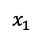
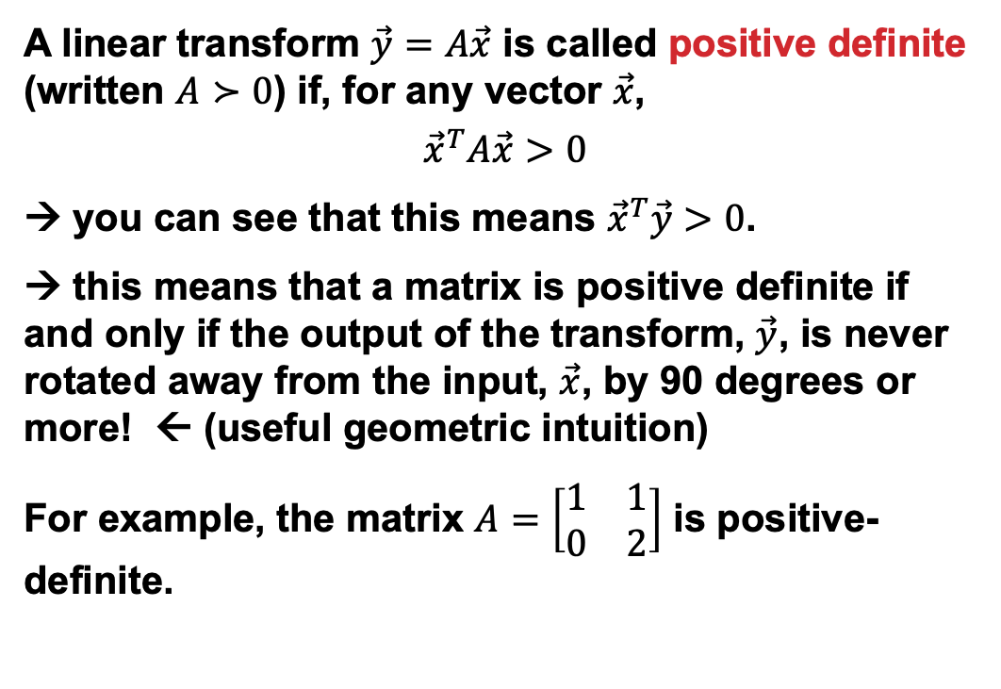
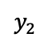
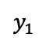
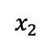
Linear Algebra Recap: Positive Definite Matrix
$$x_{2}$$
A linear transform $\vec{y}=A\vec{x}$ is called positive definite (written $A≻0$) if, for any vector $\vec{x}$,
$${\vec{x}}^{T}A\vec{x}>0$$
→ you can see that this means ${\vec{x}}^{T}\vec{y}>0$.
→ this means that a matrix is positive definite if and only if the output of the transform, $\vec{y}$, is never rotated away from the input, $\vec{x}$, by 90 degrees or more! ← (useful geometric intuition)
For example, the matrix $A=\left[\begin{matrix}1 & 1 \\ 0 & 2\end{matrix}\right]$ is positive-definite.
$$x_{1}$$
A
$$y_{2}$$
$$y_{1}$$
Slide thanks to Mark Hasegawa-Johnson

Slide 24
Quadratic Programming
A “QP” is an optimization problem with a quadratic objective function and linear constraints.
Quadratic functions → convex (“looks like a cup”)
Feasibility polytope also convex
Can also have quadratically-constrained QPs, etc
General objective: min/max xQx + c^{T}x
Sometimes these problems are easy to solve:
If Q is positive definite, solvable in polynomial time
Sometimes they’re not:
If Q is in indefinite, the problem is non-convex and NP-hard
Notes:
Problems come up a lot in power generation optimization for utility companies and finance
Q is symmetric

Slide 25
So, What if we’re not convex?
Global optimization problems deal with (un)constrained optimization of functions with many local optima:
Solve to optimality?
Try hard to find a good local optimum?
Every (non-trivial) discrete problem is non-convex:
(Try to draw a line between two points in the feasible space.)
Combinatorial optimization: an optimization problem where at least some of the variables are discrete
Still called “linear” if constraints are linear functions of the discrete variables, “quadratic,” etc …

Slide 26
Modified LP From Earlier …
Optimal solution: x = 2.5, y = 2.5
Solution value: 7.5 + 5 = 12.5
Partial paintings ...?
maximize 30x + 20y
subject to
4x + 2y ≤ 15
x + 2y ≤ 8
x + y ≤ 5
x ≥ 0
y ≥ 0
VC

Slide 27
Integer (linear) program
8
maximize 30x + 20y
subject to
4x + 2y ≤ 15
x + 2y ≤ 8
x + y ≤ 5
x ≥ 0, integer
y ≥ 0, integer
optimal IP solution: x=2, y=3
(objective 12)
6
4
optimal LP solution: x=2.5, y=2.5
(objective 12.5)
2
0
2
4
6
8
VC

Slide 28
Mixed integer (linear) program
8
maximize 30x + 20y
subject to
4x + 2y ≤ 15
x + 2y ≤ 8
x + y ≤ 5
x ≥ 0
y ≥ 0, integer
optimal IP solution: x=2, y=3
(objective 12)
6
optimal LP solution: x=2.5, y=2.5
(objective 12.5)
4
2
optimal MIP solution: x=2.75, y=2
(objective 12.25)
0
2
4
6
8
VC

Slide 29
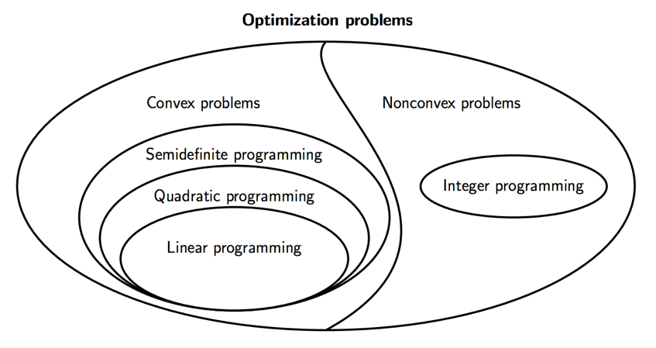
Complexity
Linear programs can be solved in polynomial time
If we can represent a problem as a compact LP, we can solve that problem in polynomial time
2-player zero-sum Nash equilibrium computation
General (mixed) integer programs are NP-hard to solve
General Nash equilibrium computation
Computation of (most) Stackelberg problems
Many general allocation problems
[Thanks Zico Kolter]
Notes:
Recall PPAD could be P, even if P \neq NP – that is, PPAD-complete weaker than NP-complete

Slide 30
LP Relaxation, B&B
Given an IP, the LP relaxation of that IP is the same program with any integrality constraints removed.
In a maximization problem, LP OPT > IP OPT. Why?
So, we can use this as a PTIME upper bound during search
Branch and bound (for maximization of binary IPs):
Start with no variable assignments at the root of a tree
Split the search space in two by branching on a variable. First, set it to 0, see how that affects the objective:
If upper bound (LPR) of branch is worse than incumbent best solution, prune this branch and backtrack (aka set var to 1)
Otherwise, possibly continue branching until all variables are set, or until all subtrees are pruned, or until LP = IP
Tighter LP relaxations → aggressive pruning → smaller trees

Slide 31
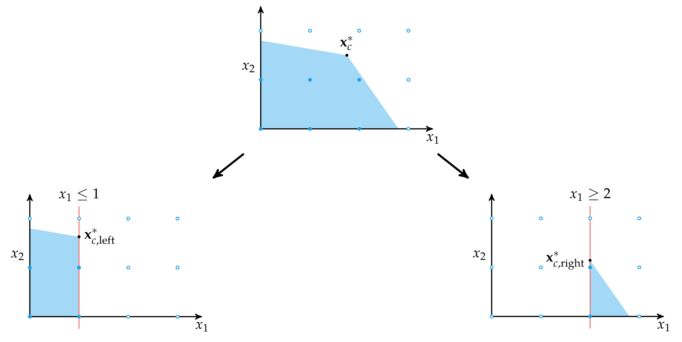
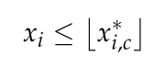
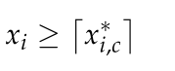
Branching

Slide 32
Cutting Planes
“Trimming down” the LP polytope – while maintaining all feasible IP points – results in tighter bounds:
Extra linear constraints, called cuts, are valid to add if they remove no integral points
Lots of cuts! Which should we add?
Can cuts be computed quickly?
Some families of cuts can be generated quickly
Often just generate and test separability
Sparse coefficients?

Slide 33

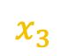
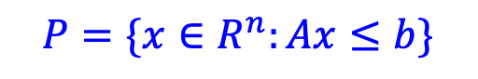
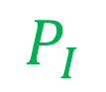
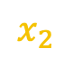
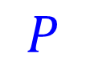
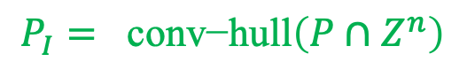
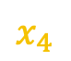
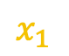
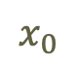
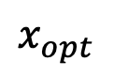
Cutting Plane Method
$$x_{0}$$
$$c$$
$$x_{2}$$
$$x_{1}$$
$$x_{3}$$
$$x_{4}$$
$$x_{opt}$$
$$P$$
$$P_{I}$$
$$P=\{x∈R^{n}:Ax≤b\}$$
$$P_{I}= \text{conv}\text{−}\text{hull}\left(P∩Z^{n}\right)$$
KC

Slide 34
Cutting Plane Method
Starting LP. Start with the LP relaxation of the given IP to obtain basic optimal solution x
Repeat until x is integral:
Add Cuts. Find a linear inequality that is valid for the convex hull of integer solutions but violated by x and add it to the LP
Re-solve LP. Obtain basic optimal solution x
Can integrate into branch and bound (“branch and cut”) – cuts will tighten the LP relaxation at the root or in the tree.

Slide 35
Practical Stuff
{CPLEX, Gurobi, SCIP, COIN-OR}:
Variety of problems: LPs, MIPs, QPs, QCPs, CSPs, …
CPLEX and Gurobi are for-profit, but will give free, complete copies for academic use (look up “Academic Initiative”)
SCIP is free for non-commercial use, COIN-OR project is free-free
Bindings for most of the languages you’d use
cvxopt:
Fairly general convex optimization problem solver
Lots of reasonable bindings (e.g., http://www.cvxpy.org/)
{Matlab, Mathematica, Octave}:
Built in LP solvers, toolkits for pretty much everything else
If you can hook into a specialized toolkit from here (CPLEX, cvxopt), do it
Bonmin:
If your problem looks truly crazy – very nonlinear, but with some differentiability – look at global solvers like Bonmin

